Slide 1
Small Wins
Lindsay Hamburg
EDU: 697 Capstone: A Project Approach
Dr. Anthony Valley
October 11, 2016

Slide 2
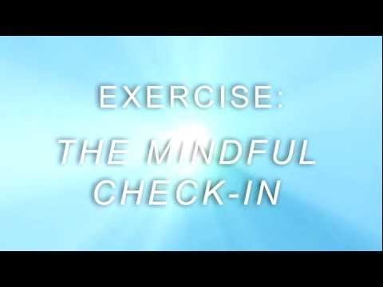
The Mindful Check-In
(www.mindful.org)
Notes:
Welcome! Thank you for joining me today to discuss progress being made in our strategy for increasing communication among departments and the importance of incorporating mindfulness into our daily routines.
Before we jump into the presentation, let’s take a few moments to have a mindful check-in and see how we are feeling. Here is a 2-minute video from The Now Effect that will help guide us through the practice of awareness. Note, before playing the video remember how you feel right at this moment.
At conclusion of video: How is everyone feeling? Do you feel different now than prior to the video?
Thank you for participating and now let’s get started on why we are here today.

Slide 3
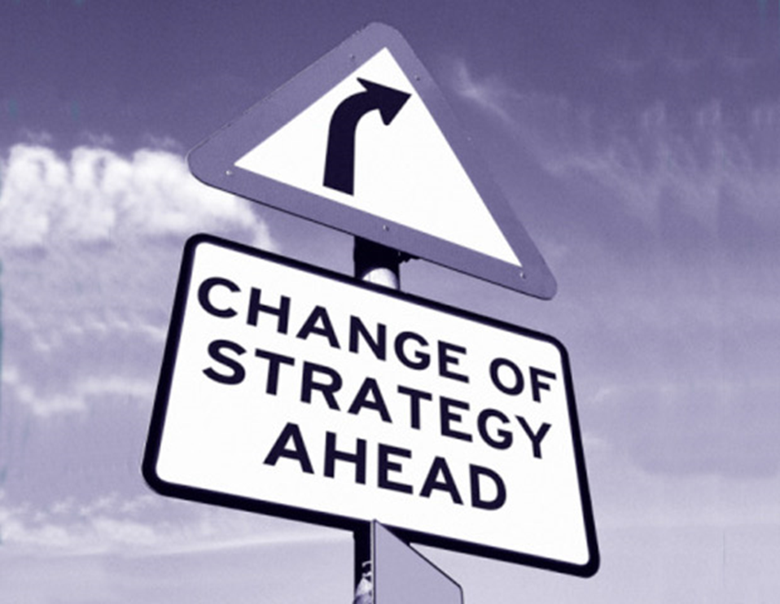
(Quotespie.com)
Notes:
As an effective leader, it is essential that I plan appropriately and incorporate small and early wins. Accomplishing a “small win” reinforces confidence in the leaders of change, along with the proposal. As a leader, I aim to foster trust, engagement, and team work. Therefore, the strategy of change includes early wins that also will help to prevent resistance as well as cultivating buy-in of the participants while ultimately enhancing support’s the organization’s mission (Spiro, 2011). This presentation provides an overview of the change strategy, the ‘small win’, the general benefits of the win, and what can be expected moving forward.

Slide 4
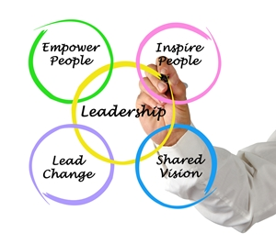
Change Strategy
(Bendelta, 2015).
Notes:
The process in which information is shared throughout an organization can be very consequential to the overall success of the organization. Leaders within the organization can improve the current status quo, empower their employees with creating channels to accessing resources and necessary information to work efficiently and independently (Stroh & Jaatinen, 2001). There is opportunity to improve communication between departments at our current organization. Open channels of communication between departments is vital in order to a free flow of information and knowledge throughout the organization.

Slide 5
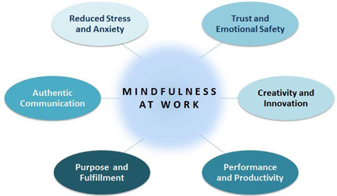
Shared Value
(mindfulness101.tumblr.com)
Notes:
As we aim to open chains of communication throughout all departments, simultaneously there will also be new channels to access for guiding the journey of mindfulness for our employees. Podcasts, activity logs, daily reminders, and guidance activities for individual and collaborative use will be accessible through the employee portal to help educate and support our staff members. Mindful awareness will penetrate through the organization creating a culture that will be more noticeably more inviting to those inside the organization and to our clients.
We are winners with mindfulness at the work place. “What you resist, persists.” – Carl Gustav Jung

Slide 6
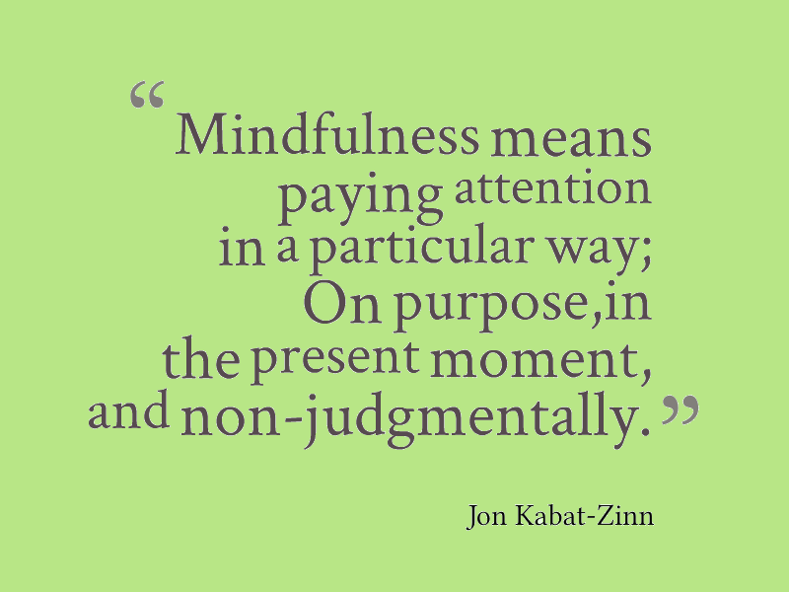
The Win
Notes:
I invited speaker, Jon Kabat-Zinn to speak to our employees about mindfulness. I consider this a ‘small win’ because of multitude of benefits that came as a result. By planning and successfully executing the event provides an opportunity for all of the stakeholders to gain confidence in my abilities. This shows my capability to work with many different departments within the organization, as well as my ability plan, execute, and deliver. This ‘small win’ is encouraging from the participants perspective as they feel valued and appreciated. And we are yet to discuss all of the benefits that results from the practice of mindfulness.

Slide 7
Benefits
Buy-in
Confidence
The Practice of Mindfulness
  Supports Self-Regulation
  Protects from toxic stress
  Effects Efficient Decision Making Capabilities
(Congleton, Hölzel, & Lazar, 2015).
Notes:
Hosting a speaker and inviting all of the participants provide a plethora of benefits and is a ‘small win’. Pre and post surveys assessing views of readiness levels, opinion of work place culture, and level of mindfulness. The participants expression a sense of gratitude in terms of the organization increased when surveyed post event. The results showed that this type of knowledge is relevant to both personal and professional development.

Slide 8
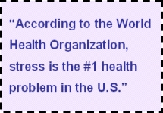

Avoid Stress, Achieve More
(http://mindfulnessatwork.net.au/)
Notes:
We all get stressed with the fast pace life styles we lead, expectations at work; let’s slow down take five minutes throughout the day to just breathe.

Slide 9
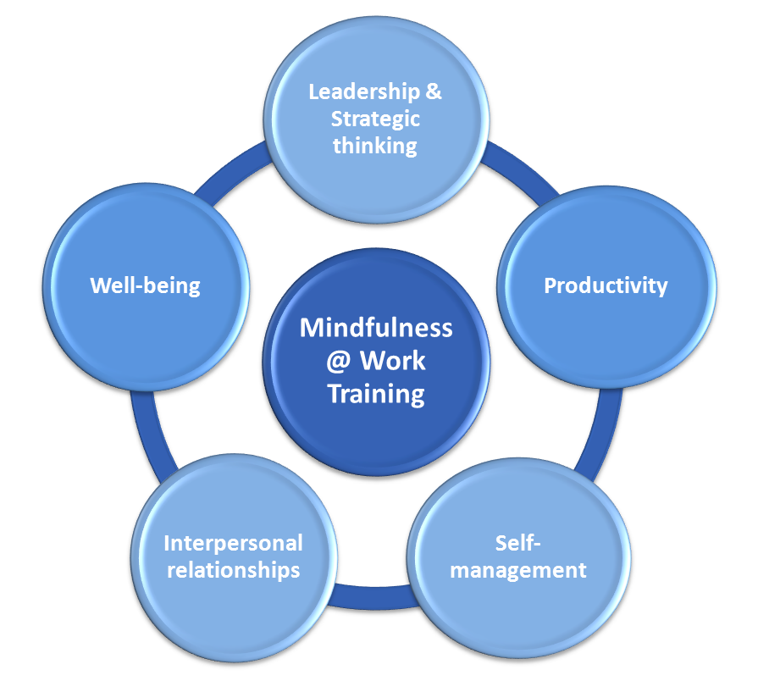
Mindfulness at the Workplace
(http://mawt.co.uk/)

Slide 10
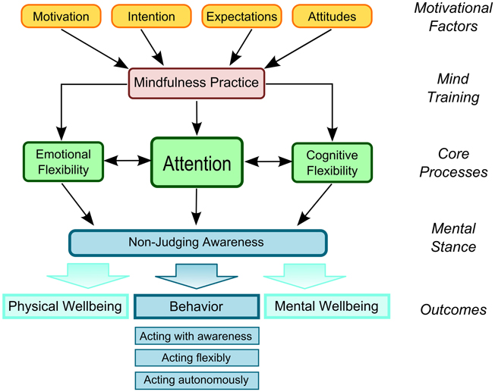
Mindfulness at the Workplace
(http://journal.frontiersin.org)

Slide 11
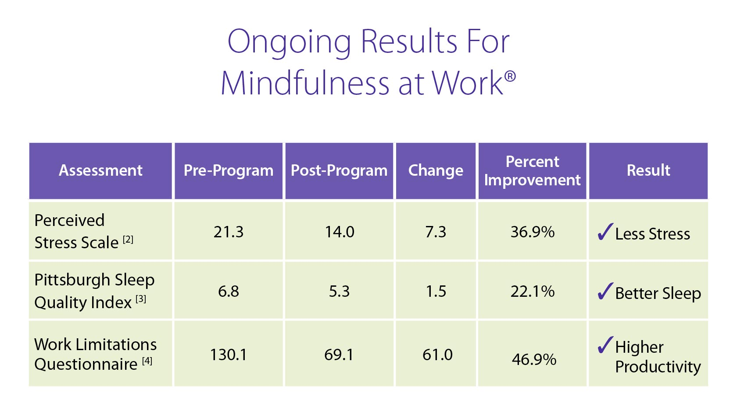
Data & Results
(Prweb.com)
Notes:
83% of participants stated “taking time each day to optimize my personal productivity” compared to 23 % in the pre survey. 82% in the post survey state they now make time to eliminate tasks with limited productivity value –compared to 32 % in the pre-survey. And among senior executives who took the course, 80 % reported a positive change in their decision making better decisions, while 89 per cent said they became better listeners.

Slide 12
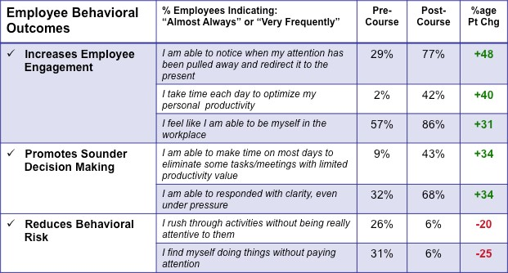
Data & Results
(https://instituteformindfulleadership.org/research)

Slide 13
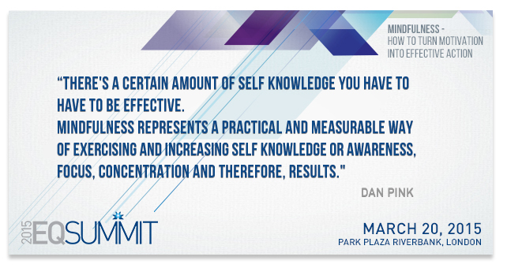
Results

Slide 14
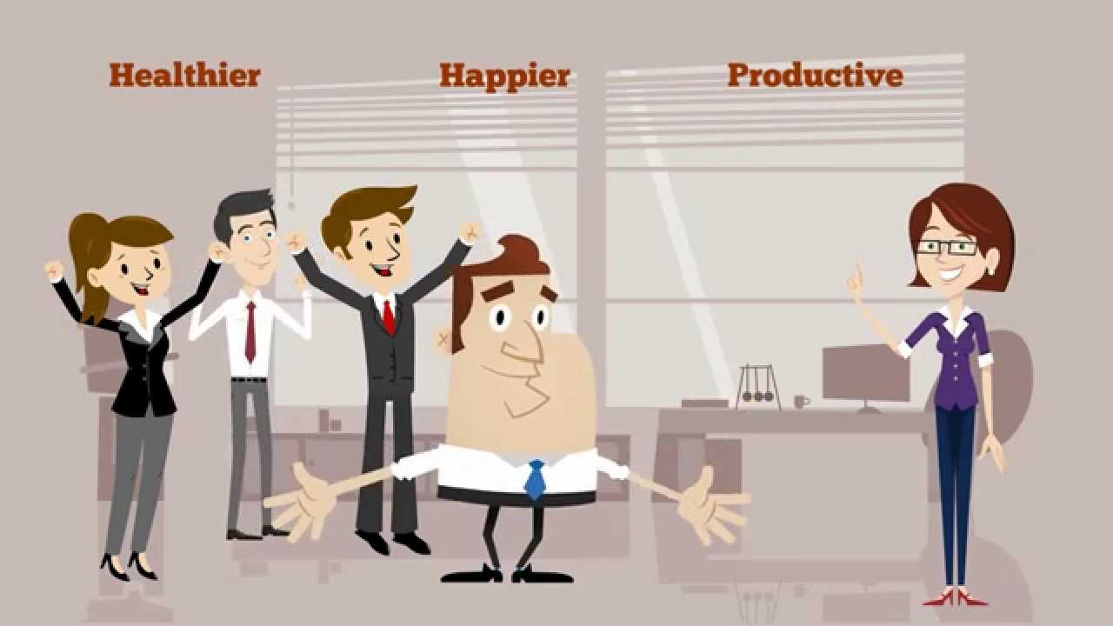
Well-Being
(TheMindulnessNewtowk.com)
Notes:
According to Bureau of Labor Statistics, 2000, workplace stress cost American corporations approximately $9,500 per employee every year in health care, resulting in lowered productivity, absenteeism, high turnover, legal and insurance costs.

Slide 15
Moving Forward
Begin every day with Gratitude
Integrate what has been learned in busy work days
Start each day in reflection of personal purpose and commitment to organizational purpose
5 min. breaks to reflect and relax
Notes:
Our speaker, Jon Kabat-Zinn, was very well received by the audience members. Many vocal requests for more types of activities in information on subject . I would like to create a wiki-like-pages following the change strategy with a section on mindfulness. The page will include daily reminders, trainings, resources, and for input and collaboration. I am remaining on a local level until the change strategy to be implemented, digested, and embraced prior creating a change at the organizational level. Behind the scenes, I will be tracking and sharing information. I want an organic following to develop which will allow me to even continue the development long term.

Slide 16
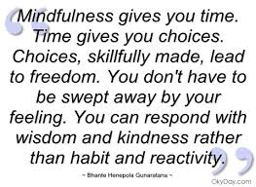
Be Mindful

Slide 17
Reflect
As each year concludes, our organization reflects and accesses success and area of opportunity moving forward; employee attendance was stated as an area of opportunity in the future year. The organization does include an onsite gym with machines and weights, and other options for easy and accessible health needs.
Notes:
As each year concludes, our organization reflects and accesses success and area of opportunity moving forward; employee attendance was stated as an area of opportunity in the future year. The organization does include an onsite gym with machines and weights, and other options for easy and accessible health needs.

Slide 18
Mindfulness
Impact and influence
Helps to maintain a healthy
Mind
Body
Spirit
a positive work environment
openness to change
lower level of stress
Notes:
All leading to a more effective and efficient work environment.
Mindfulness helps to maintain a healthy mind, body, and spirit. An impact and influence includes a positive work environment, openness to change, lower level of stress all leading to a more efficient organization. As many large organizations are promising to incorporate mindfulness into its’ culture, there is currently abundant recourses and ideas presently available.
Thank you for your time and presence. Let’s conclude in three deeps breathes.

Slide 19
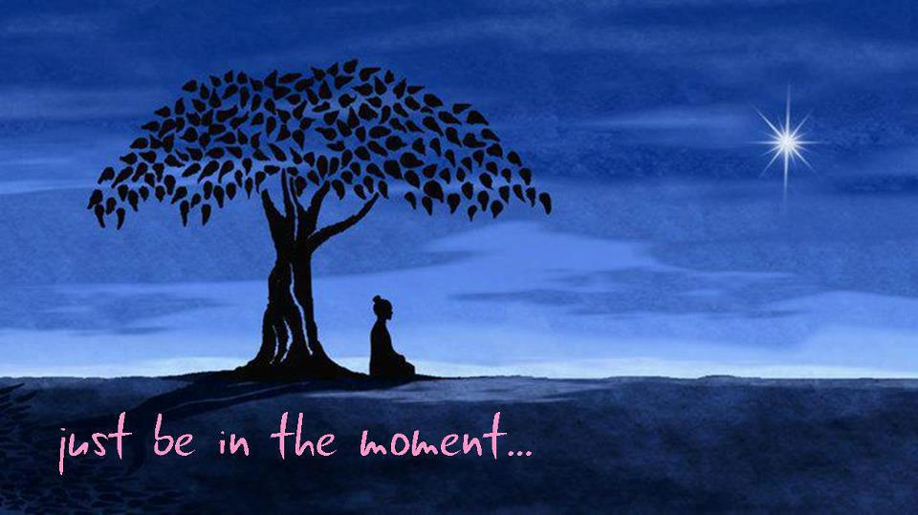
Mindfulness
(http://fieldviewfestival.co.uk/workshops/introduction-to-mindfulness)
Notes:
In order to experience real change one must learn to be mindful (Frederick, 2014).
Let’s conclude now by taking three deep breaths. Clear your mind and only focus on your inhale and now exhale, inhale and now exhale, and take and deep breath in and out. Take a moment and how do you feel?

Slide 20
References
Congleton, C., Hölzel, B., & Lazar, S. (2015, January 8). Mindfulness Can Literally Change Your Brain. Harvard Business Review, Retrieved October 27, 2015.
Ferrance, E. (2000). Themes in education: Action research. Providence, RI: LAB at Brown University. Retrieved from http://www.brown.edu/academics/education-alliance/sites/brown.edu.academics.education- alliance/files/publications/act_research.pdf
Frederick, R. (2014, March 13). Cultivating Emotional Mindfulness: What, Why, and How…. Retrieved August 10, 2015, from http://behavior.net/2014/03/cultivating-emotional-mindfulness-what-why-and-how/
McEwen, B., & Gianaros, P. (2011). Stress- and Allostasis-Induced Brain Plasticity. Annual Review Of Medicine, 62(1), 431-445. doi:10.1146/annurev-med-052209-100430
Spiro, J. (2011). Leading change step-by-step: Tactics, tools, and tales. San Francisco, CA: Jossey-Bass.

Slide 21
References
Images Retrieved from
Bendelta: http://www.bendelta.com/
Frontier: http://journal.frontiersin.org
Mindful: http://www.mindful.org/
Mindfulness at Work Training: http://mawt.co.uk/
The Mindfulness Network: http://www.themindfulnessnetwork.com/website-and-articles.html

